Slide 1

C++Test
By: Tuan Nguyen Manh
Course duration: 3 hours
Last update: Dec 2008

Slide 2

Content
Overview
C++Test Concepts
C++Test GUI Overview
Testing Your Code
Working With Test Results
Customizing Tests and Settings

Slide 3
Content by Staff Level
For 1-year engineer (junior engineer)
Overview
What is C++Test?
What features dose C++Test support?
C++Test Concepts
C++Test GUI Overview
Testing Your Code
For 3-year engineer (lead engineer)
Overview
How Does C++Test Work?
Why Do Developers Need C++Test?
Where Can Developers Use C++Test?
Working With Test Results
Customizing Tests and Settings
For 4-year or higher engineer (senior engineer)
Overview
Customizing Tests and Settings

Slide 4
Overview
What is C++Test?
How Does C++Test Work?
Why Do Developers Need C++Test?
Where Can Developers Use C++Test?
What features dose C++Test support?

Slide 5
What is C++Test?
C++Test was first introduced in 1999, designed specifically to relieve developers, QA personnel, and other software team members from the burden of manually creating test harnesses, stubs, and test cases.
C++Test is very easy to use. It automatically performs static analysis on C or C++ code.
Using hundreds of industry-standard coding rules.
Automatically performs unit testing, to test code construction and functionality.
All of the unit tests generated by C++Test are fully customizable.
In addition, C++Test maintains code integrity through automated regression testing, ensuring that no new errors are introduced when changes are made to the code.

Slide 6
How Does C++Test Work?
Using C++Test’s built-in Static Analysis feature
Reads the source code
Automatically checks standard coding rules
Suppresses rules as you indicate
Enables fully customized testing — without programming or scripting —using its built-in RuleWizard feature
During unit testing, C++Test reads your source code and immediately understands how to test the code on its own, without human intervention.
Reads the code and creates harnesses, stubs, and test cases
Fully customizable tool that allows you to create your own test cases, export or import test cases or objects, or use existing test suites to meet your unique needs

Slide 7
Why Do Developers Need C++Test?
Instant verification: programmers can instantly check that the code they built works correctly. Testing code as it is written allows you to easily detect and prevent software bugs, with minimal cost.
Instant access to a C and C++ knowledgebase: C++Test contains a wealth of programming best practices within its coding rules.
Ease of use: it does everything on its own - you don’t need to do anything to begin testing code. Anyone from Developers to QA to Customer Service Representatives can perform unit testing with the click of a button.

Slide 8
Where Can Developers Use C++Test?
As part of his personal development toolbox
C++Test can be use with any IDE and in any environment
As part of a group development environment
Is fully configurable for entire development group
Allowing the exchange of test and development information
Enables reporting for easy test result distribution among development group members
Enables each of the roles in a development group - Developers, Architects, and Product Managers - to actively participate in the prevention of errors throughout the entire software development lifecycle

Slide 9
What features dose C++Test support?
Static analysis of code for compliance with user-selected coding standards
Graphical RuleWizard editor for creating custom coding rules
Static code path simulation for identifying potential runtime errors
Automated code review with a graphical interface and progress tracking
Automated generation and execution of unit and component-level tests
Flexible stub framework
Full support for regression testing
Code coverage analysis with code highlighting
Runtime memory error checking during unit test execution
Full team deployment infrastructure for desktop and command line usage

Slide 10
C++Test Concepts
Project Configurations
Test Configurations
Coding Standard Analysis
Unit Testing

Slide 11
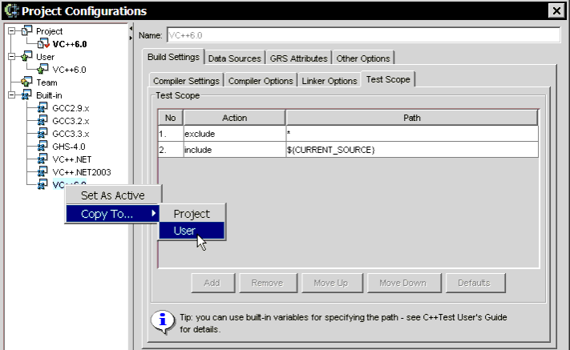
Project Configurations
Is a collection of settings that defines the settings applied to a project
Allow user can adjust some settings such as: Compiler, Linker, Test Scope,…
Project Configurations can be shared among different users and different projects via Parasoft's Team Configuration Manager (TCM)

Slide 12
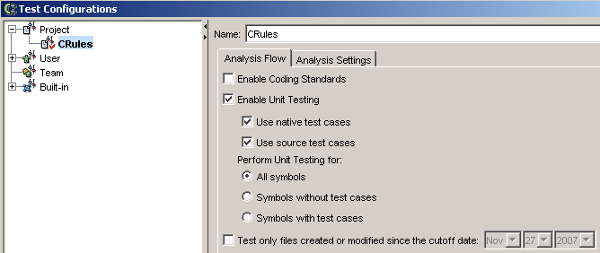
Test Configurations
Is a collection of settings that define a test scenario
Test Configuration determines parameters such as:
The type of tests performed (coding standard checking, test case generation, regression testing, etc.)
Number of needed test case generation.
The rules checked during coding standard analysis
The parameters for automatic test case generation
A single Test Configuration can be applied to multiple projects or shared amongst multiple users.

Slide 13
Coding Standard Analysis
These rules are designed to reduce the possibility of introducing errors, as well as increase code portability and maintainability.
Effective C++: Rules based on Scott Meyers’ Effective C++. These rules check the efficiency of C++ programs.
Coding Conventions: Rules that check if coding conventions are applied.
Metrics: Rules that measure the size and complexity of code.
…
You can use the RuleWizard GUI to create or modify a rule in order to create custom coding standards.

Slide 14
Unit Testing
Manual unit testing typically involves writing test harnesses by hand, specifying input data, and supplying stubs for missing functions
C++Test supports three types Unit Testing:
White-Box Testing: checks that all of a class’ methods or functions (including protected and private)
Black-Box Testing: focuses only on method inputs and outputs; it does not consider the object state or external variables
Regression Testing: No new test cases are generated, automatically performs regression testing by re-executing the same test cases previously generated when any code modifications
C++Test supports two types of unit test cases:
Native test cases: C++Test proprietary format test cases that can be set up, reviewed, and edited via C++Test GUI controls.
Source test cases: Test cases that are implemented in C or C++ source code and can be validated and extended by adding CppUnit-like source code in a text editor or IDE.

Slide 15
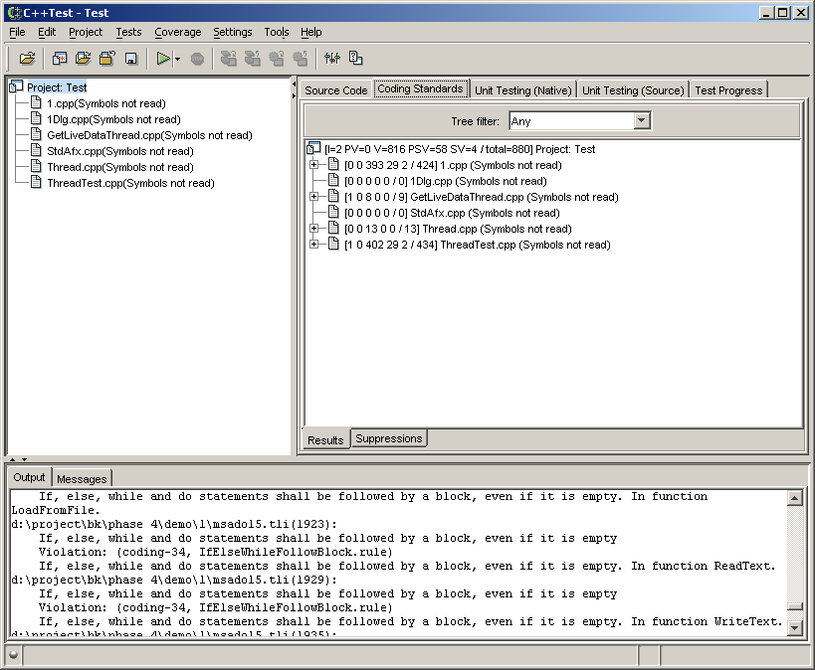
C++Test GUI Overview
Test Tabs
Project Tree Panel
Main GUI Panel
Out/Message Panel

Slide 16
Testing Your Code
Preparing for Tests
Testing from C++Test GUI

Slide 17
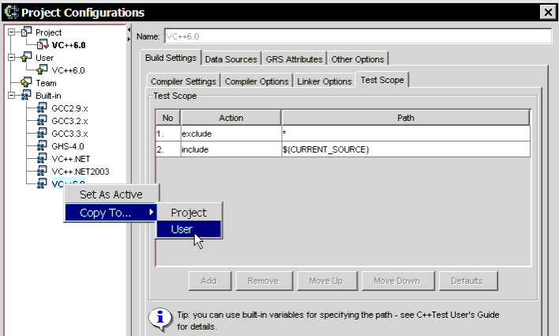
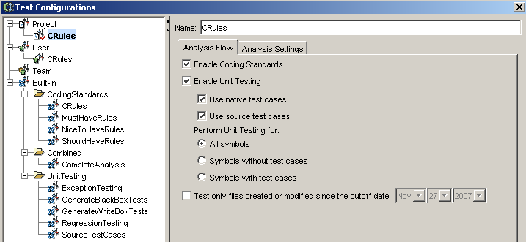
Preparing for Tests
Selecting and Customizing Project Configurations
Choosing Project> Project Configurations
Selecting and Customizing Test Configurations
choosing Tests> Test Configurations

Slide 18
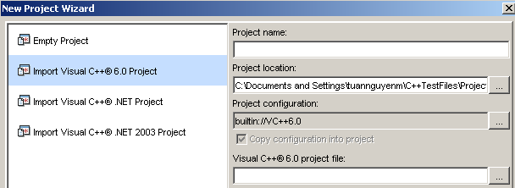
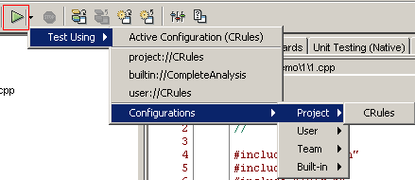
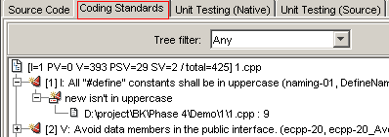
Testing from C++Test GUI
Opening Files/Projects For Testing
Choose File > New Project or press CTRL-N. C++Test launches the New Project Wizard
Performing Coding Standard Analysis
In the Project Tree panel, select the file(s) that you want to test
Do one of the following
Click the Test Using button in the tool bar
Choose the appropriate configuration from the Test Using section
Review result
Coding Standards tab Results sub-tab (in the main GUI area)
Source Code tab

Slide 19
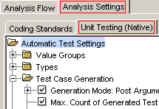

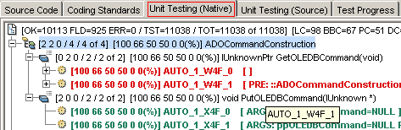
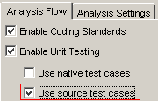
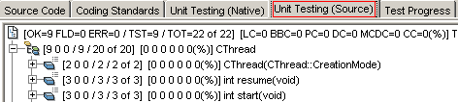
Testing from C++Test GUI (cont)
Performing Unit Testing with Native C++Test Test Cases
Enable [Use native test cases] in [Test Configuration]
Configuration native test cases
Review result
Unit Testing (Native) tab Results sub-tab (in the main GUI area)
Performing Unit Testing with Source Test Cases
Enable [Use source test cases] in [Test Configuration]
Review result
Unit Testing (Source) tab Results sub-tab (in the main GUI area)

Slide 20
Working With Test Results
Viewing Test Results and Output
Viewing/Editing Source Code
Generating HTML Reports
Generating XML Reports
Monitoring Unit Test Coverage

Slide 21
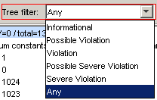
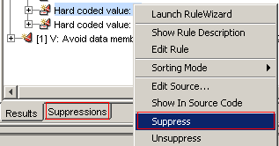



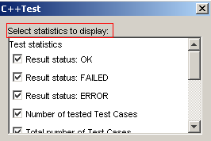

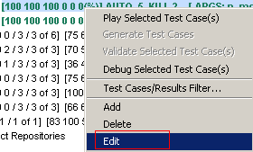
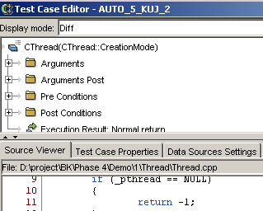
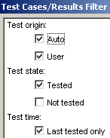
Viewing Test Results and Output
Viewing Coding Standards Analysis Test Results
Filtering Messages
Viewing Rule Descriptions
Suppressing Messages
Editing Source Code
Viewing Results for Unit Testing with Native Test Cases
Viewing Unit Test Information
Viewing Coverage Statistics Information
Controlling Coverage Statistics Results
Viewing Specific Test Case Details
Filtering Test Cases

Slide 22
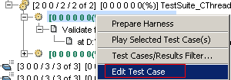
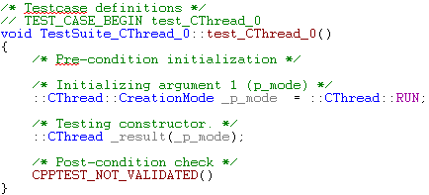
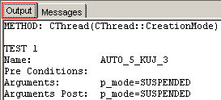
Viewing Test Results and Output (cont)
Viewing Results for Unit Testing with Source Test Cases
Viewing Coverage Statistics Information
Controlling Coverage Statistics Results
Filtering Test Cases
Viewing Specific Test Case Details
It will link to C++ editor
Viewing Text-Format Output
Working With Results and Output
Edit source code
Save your output
Replay selected test cases
View coverage information for unit test cases

Slide 23
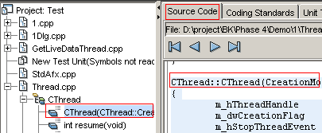

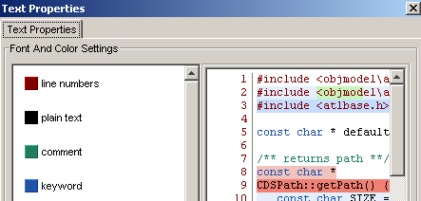



Viewing/Editing Source Code
Viewing Source Code
Click the Source Code tab
In the Project Tree Panel, select the file you want to view
Customizing the Source Viewer
Changing Your Source Code Editor
Refreshing the Project Tree to Reflect Code Modifications
C++Test's Project Tree panel is based on your source at the last time that you read symbols or built an executable

Slide 24

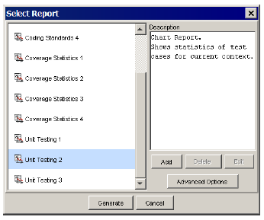
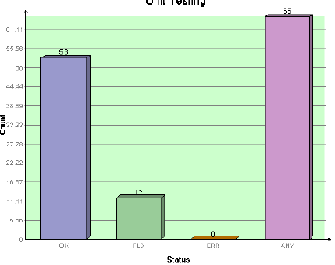
Generating HTML Reports
Creating a Standard HTML Report
Choose File> Generate HTML Report
Click [Common Setting] button to configure saved HTML Report
Understanding the Default Report Templates
Detailed Report
Summary Report
Coding Standards 1..5
Coverage Statistics 1..7
Unit Testing 1..6
Changing the Report Location, Header/Footer and Other Report Options

Slide 25
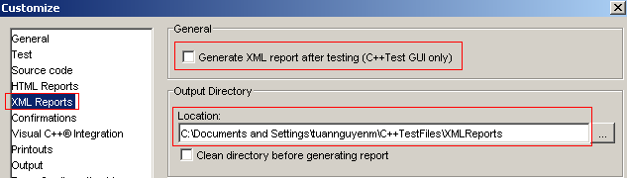
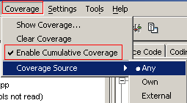
Generating XML Reports - Monitoring Unit Test Coverage
Generating XML Reports
Choosing Settings > Customize
Monitoring Unit Test Coverage
Enabling Coverage
Coverage > Enable Cumulative Coverage
Coverage > Coverage Source: Any, Own, External
Source Coverage
Coverage>Show Coverage
The Coverage Window
Line Coverage
Basic Block Coverage
Branch (Decision) Coverage
Path Coverage
Modified Condition/Decision Coverage (MC/DC)
Condition Coverage

Slide 26
Customizing Tests and Settings
Coding Standard Analysis
Unit Testing with Native Test Cases
Unit Testing with Source Test Cases

Slide 27





Coding Standard Analysis
Configuring Coding Standard Analysis Settings
Determine exactly what rules are checked
Create custom rules by RuleWizard
Use GUI controls to suppress the reporting
Define rule suppressions directly in your source code
Refresh the available rules from disk
Review/modify existing rule set properties
#pragma codewizard suppress item mecpp-02
#pragma codewizard unsuppress item * class MyClass line 10-* 1

Slide 28
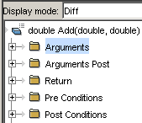






Coding Standard Analysis (cont)
Unit Testing with Native Test Cases
Customize how tests are generated
Update the test suite when function signatures change
Indicate that the actual values for a failed test case are actually the correct values
Modify the outcome of valid or failed test cases
Add user-defined test cases
Export or import test cases and test objects
Change automatically-generated stubs or enter new stubs
Configure module testing: test multi files
Debug Selected Test Case

Slide 29
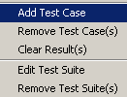

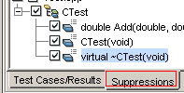
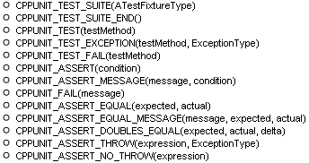
Coding Standard Analysis (cont)
Unit Testing with Source Test Cases
Add, modify, or remove test cases or test suites
Update the test suite when function signatures change
Suppress the testing of designated classes or methods
Integrate legacy CppUnit test cases into C++Test

Slide 30

Question and Answer

Slide 31
Exercise / Questionnaire

Slide 32
Appendix: Course detail form
Author
Tuan Nguyen Manh
Duration
3 hours
Category
Software Engineering
Type
Theory / Theory and Practice
Examination | Review questions / quiz will be at the end of the course. The purpose is to review the awareness of all attendees on some important points of this course
Intended Audience | Any software technician, engineer, project leader, project manager, manager who are working in software related projects.
Pre-requisites | Those who have basic knowledge of C++
Completion criteria for the course | Attendee must join at least 80% of course length and finish the review questions section with score rate of 75% or higher.
Criteria for granting training waivers | Those who has experience on C++ Test, or already attended similar courses

